Slide 1


Purwadhika JCDS 1202 Final Project -
Matplotlib Team

Slide 2

Hello!
We are Matplotlib Team
In this final project, we were assigned to make a regression machine learning model using DC Properties dataset

Slide 3

Table of Contents
01
02
03
04
Background & Problem Identification
Data Understanding & Data Exploration
Modeling & Evaluation
Deployment

Slide 4
1.
Background & Problem Identification

Slide 5

Background
We position ourselves as a Data Scientist Team working at MPL Bank located in Washington DC, USA.
We are assigned to work on a project to develop a Machine Learning (ML) solution for Underwriter Team of MPL Bank. We will help the Underwriter Team to make an improvement in their process of underwriting, specifically in the process of property appraisal and valuation.

Slide 6
Problem Identification
Problem
Definition
Business Objectives
Data Requirements
Analytic Approach
Action
Value

Slide 7
Problem Identification
Based on the elicitation process with Underwriter Team, we found that they want to improve the accuracy of their underwriting process, specifically in the process of appraisal.
Why ?
Appraisal process directly affects company’s revenue The result would determine whether to give credits/mortgage to customer, or not.
Property values are appraised by AMC, and then checked by MPL Bank’s internal appraisal team This is where we comes in, to help the process of checking & comparing property appraisal evaluation process.
AMC : Appraisal Management Company

Slide 8
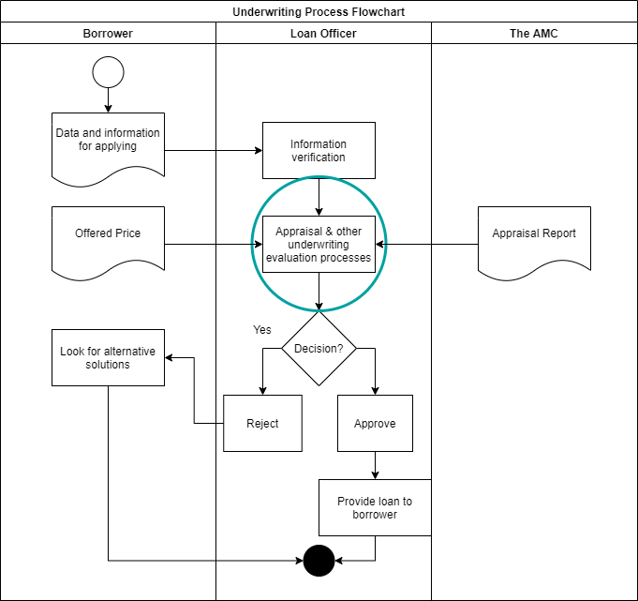
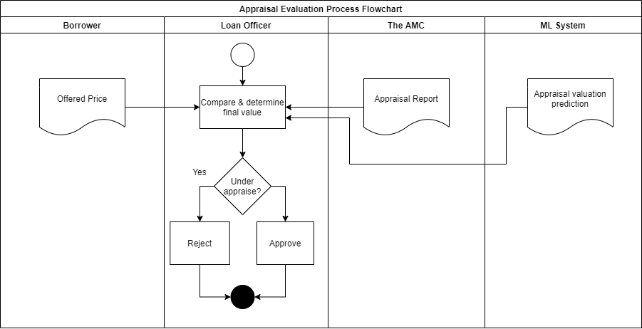
Appraisal Process

Slide 9
Business Objectives
Maximize profit by helping underwriter team to make the right decision whether to give a loan or not, with an optimal amount.
Minimize loss originated from fraud and erroneous valuation.
Notes: In this project we were asked to reach the Mean Absolute Error (MAE) metrics at most 13 % to the median of property price

Slide 10
Data Requirements
Based on the Dataset we have in hand, the required information to make a prediction are the geospatial location and property features of the house
(e.g., gross building area, the number of rooms, the number of bedrooms, etc), the condition of the house, the location, etc.)

Slide 11
Analytic Approach
Machine Learning Techniques
Since the value (price) that we want to predict is a continuous value, we addressed with Supervised Learning, more specifically Regression. We will feed the data in the training set to Regression algorithms, tune some parameters to fit the model, and then hopefully it will be able to make good predictions on future/unknown instances.
Risk
The risk that may be caused by wrong ML prediction would be profit loss especially when the model gives under appraised value (price).
Performance Measures
The performance measures to evaluate the ML model are Mean Squared Error (MSE), Root Mean Squared Error (RMSE), Mean Absolute Error (MAE), the Coefficient of Determination (R²), with considering MAE as the vital metrics as agreed with Underwriter Team.
Notes:
RISK : ELABORATE 2 Possible risks.

Slide 12
Action
Value
The business user can utilize the prediction result by comparing it with the appraisal value given by the AMC to determine a reasonable property value.
To improve the underwriting process by providing a good appraisal prediction model and thus helps business user to make the right business decision, resulting in maximized profit and minimized loss

Slide 13
2.
Data Understanding & Data Exploration

Slide 14
Data Understanding

Slide 15
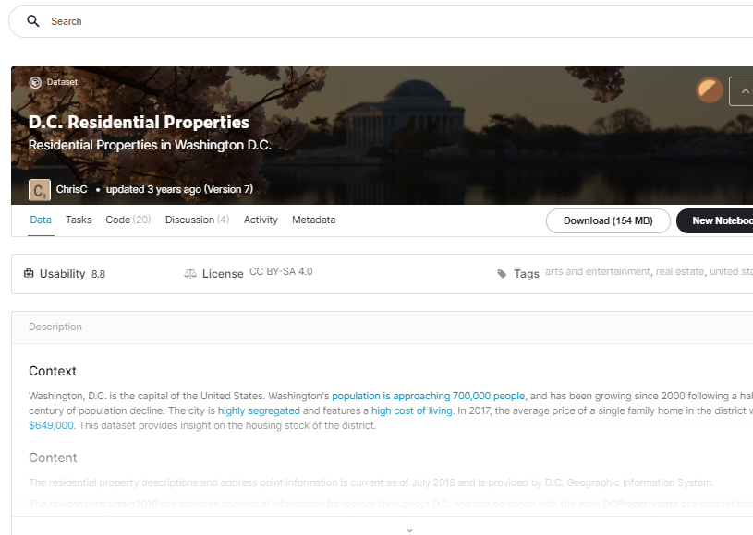
Data Collection
The data was downloaded from Kaggle. All data is available at Open Data D.C.. The residential and address point data is managed by the Office of the Chief Technology Officer.
Distribution Liability: Data Terms and Conditions

Slide 16
Residential Data
106,696 rows
49 columns
Data Source
Number of Rows
Number of Columns

Slide 17
Data Description
Field | Description
BATHRM | Number of Full Bathroom
HF_BATHRM | Number of Half Bathroom
HEAT | Heating System
AC | AC Availability
NUM_UNITS | Number of Units
ROOMS | Number of Rooms
BEDRM | Number of Bedrooms

Slide 18
Data Description
Field | Description
AYB | The earliest time the main portion of the building was built
EYB | The year an improvement was built more recent than actual year built
QUALIFIED | Government’s Criteria on whether the sale is representative of market value
GBA | Gross Building Area (in sqft)
STYLE | Style
STRUCT | Structure
GRADE | Grade

Slide 19
Data Description
Field | Description
CNDTN | Condition
EXTWALL | Exterior Wall
ROOF | Roof Type
INTWALL | Interior Wall
KITCHENS | Number of Kitchens
FIREPLACES | Number of Fireplaces
LANDAREA | Land Area (in sqft)

Slide 20
Data Description
Field | Description
LATITUDE | Latitude
LONGITUDE | Longitude
ASSESSMENT_NBHD | Neighborhood ID
WARD | Ward
QUADRANT | City Quadrant (NE, SE, SW, NW)
SALEDATE | Date of Most Recent Sale
PRICE | Price

Slide 21
Data Pre-Processing

Slide 22
Data Pre-Processing
Drop Unused Columns
Unnamed: 0, SALE_NUM, CMPLX_NUM, LIVING_GBA, X, Y, ASSESSMENT_SUBNBHD, SOURCE, CITY, STATE, NATIONALGRID, GIS_LAST_MOD_DTTM, CENSUS_BLOCK, YR_RMDL, STORIES, FULL_ADDRESS
Fill Missing Values
AYB, QUADRANT, AC, NUM_UNITS
Drop Rows with Missing Values
SALEDATE, KITCHENS, ROOMS, GRADE, HEAT, BATHRM
Merge Values with Very Few Occurrence
CNDTN (Default → Good)
GRADE (Low Quality → Fair Quality)

Slide 23
Data Pre-Processing
Exclude Outliers
KITCHENS, PRICE, Price in CNDTN
Re-classify Columns
CNDTN, STRUCT, ROOF
Create New Columns
ayb_age = Present Year - AYB
eyb_age = Present Year - EYB
Drop Unusual/Erroneous Data
BEDRM > ROOMS
SALEYEAR <= 1991
EYB < AYB

Slide 24
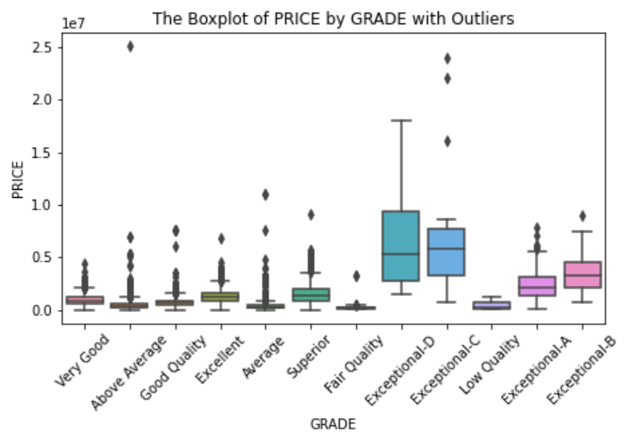
Identifying Outliers in PRICE
Exceptional Grade
Has very different prices compared with the rest of other grades
We limit the capability of our model in this project to predict an output only for properties with grade lower than Exceptional since Exceptional properties have a price range that is very different than the rest of other grades and another model needs to be built specifically for them.

Slide 25
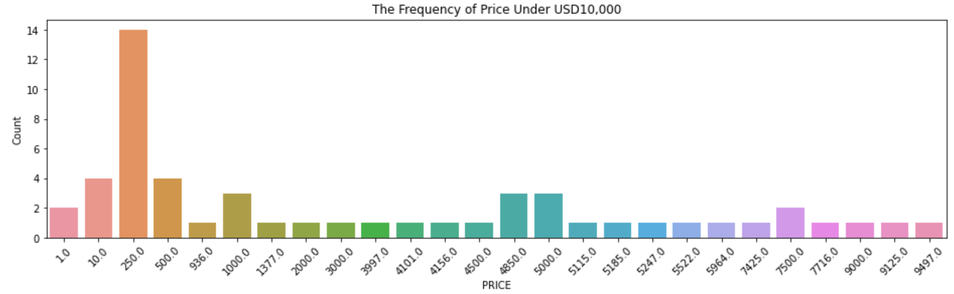
Erroneous PRICE
We found few suspicious data where properties were being sold for a very low price. We obtain the information that the median of the whole USA residential price is around ±USD50,000. Thus based on this information, we drop data points with an assumption that there are very few cheap properties with values as low as one-fifth to the median price, which is USD10,000.

Slide 26
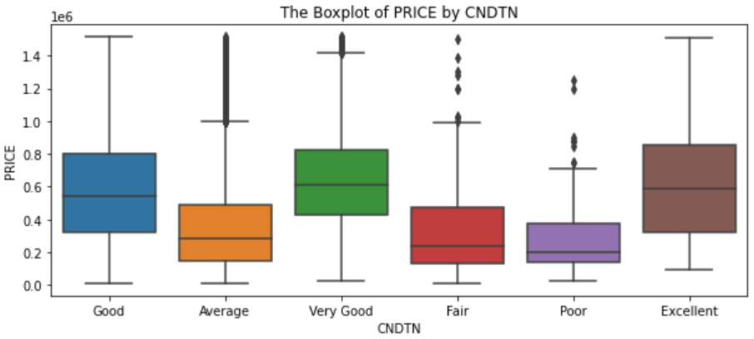
Re-classify CNDTN
Price Median : USD420,000
There are some overlap between categories, but between 'Fair, Poor, Average' vs 'Good, Very Good, Excellent' they differ quite significantly; as such CNDTN still could potentially be a good predictor of price.
We re-classify the categories in CNDTN into 2 groups :
0 : Poor (Under median)
1 : Good (Above median)

Slide 27
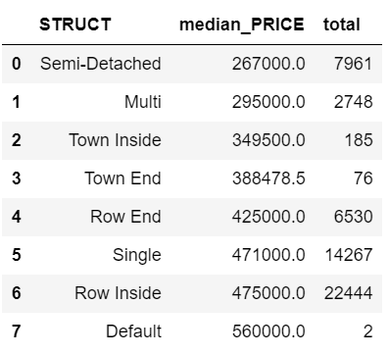
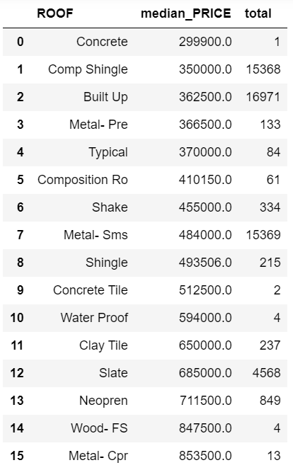
Re-classify STRUCT & ROOF
Price Median : USD420,000
We re-classify the categories in STRUCT and ROOF into 2 groups :
0 : Under median
1 : Above median

Slide 28
Insights

Slide 29
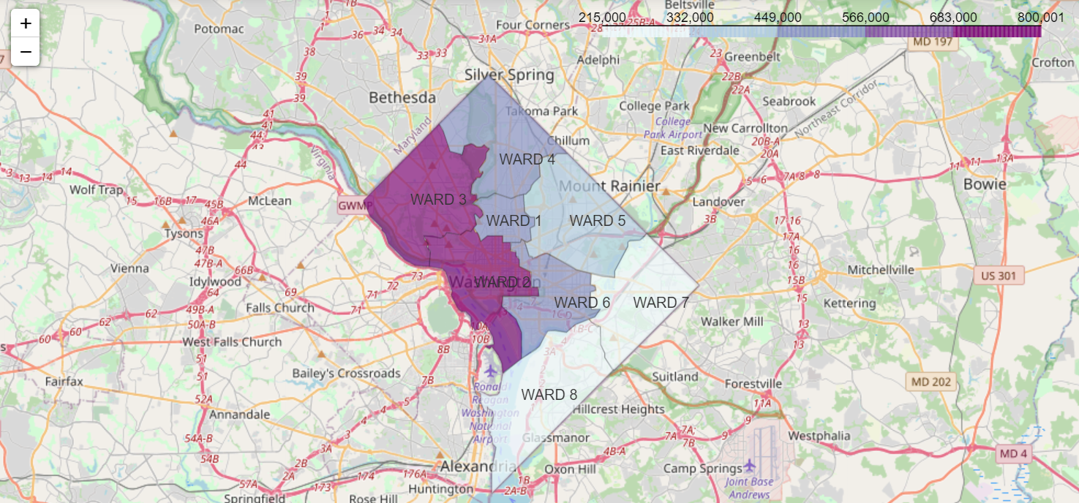
Map by Ward

Slide 30
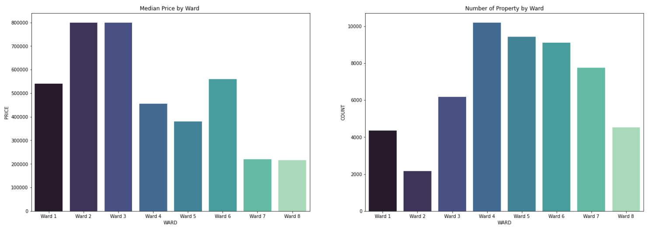
Median Price & Number of Property by Ward

Slide 31
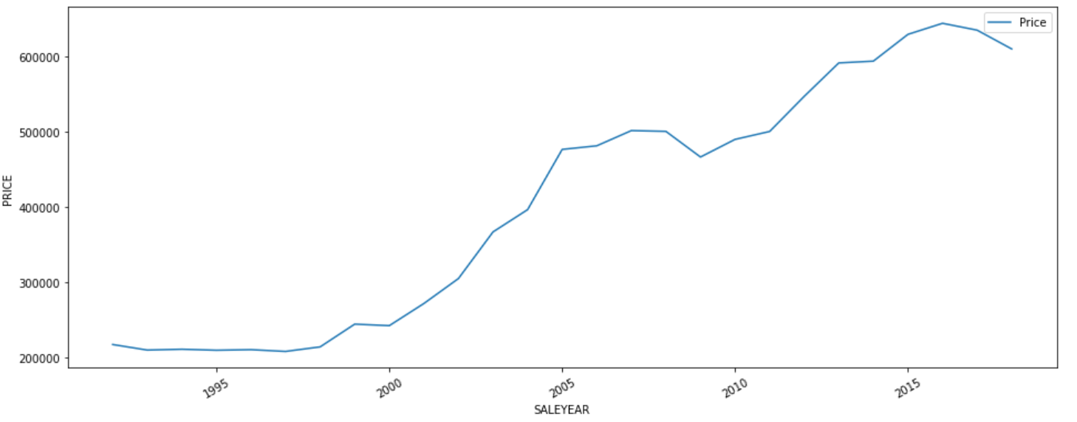
Sale per Year

Slide 32
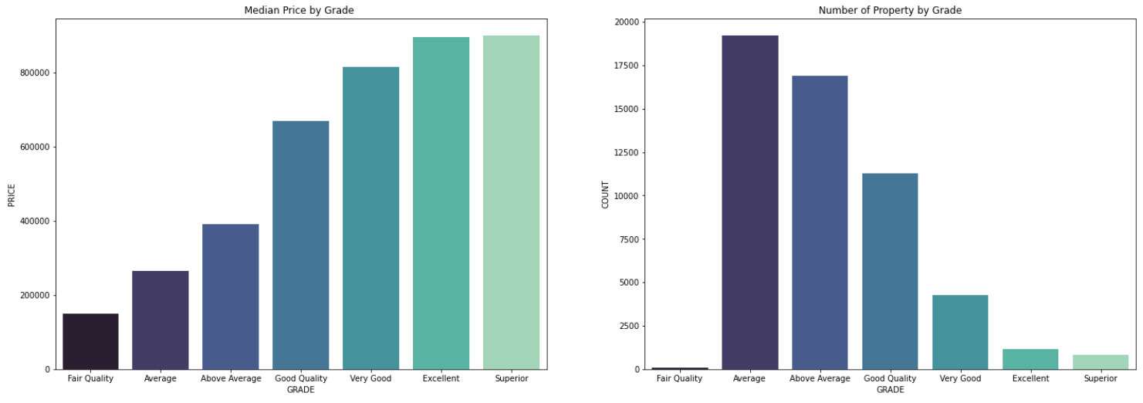
Median Price & Number of Property by Grade

Slide 33
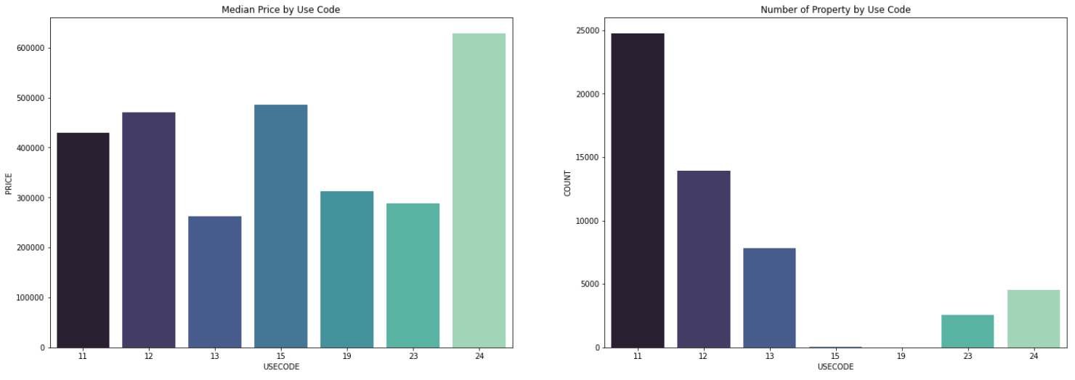
Median Price & Number of Property by Use Code

Slide 34
3.
Modeling & Evaluation

Slide 35
Modeling Step
Encoding categorical features and scaling numerical features
Check different baseline model of Regression Model
Use Grid-Search to get best parameters of the best baseline-model
We choose the best model based on the R2 score and Mean Absolute Error (MAE).

Slide 36
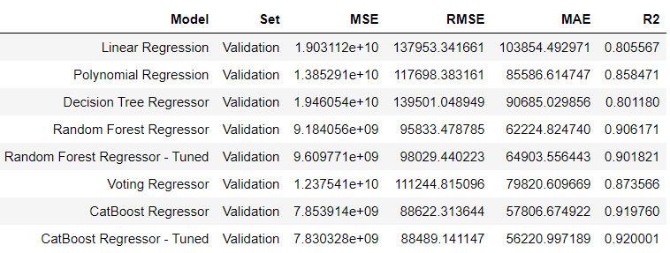
Model Assessment
From the table, we can see the Catboost Regressor - Tuned has the best R2 and MAE score.

Slide 37
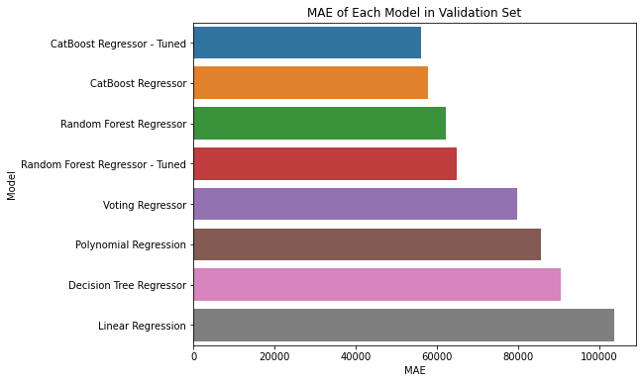
From the graph, we can see the Catboost Regressor - Tuned has the lowest Mean Absolute Error score than other models.

Slide 38
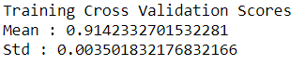
Evaluation
We do the cross validation test for our best model to check how consistent the model and results are when measurement is repeated.
From the cross validation test, we still get a good result.

Slide 39
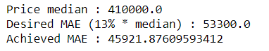
Evaluation
In this project, we were asked to reach the Mean Absolute Error (MAE) value below 13% of the median property price.
From the result shown above, we have achieved the desired MAE value (under 53,300).

Slide 40
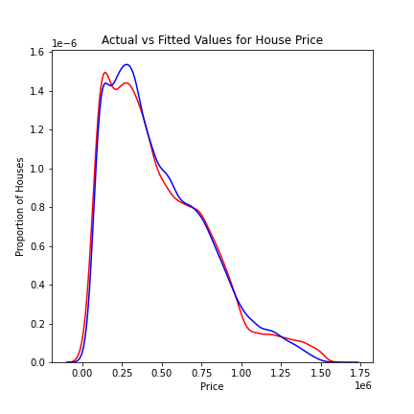
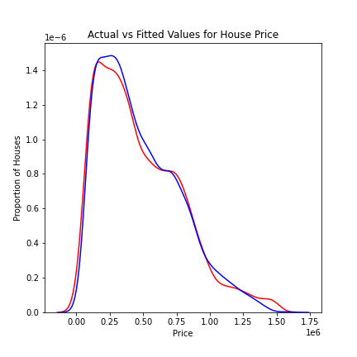
Evaluation
Train set
Test set
We finally chose Catboost Regressor with tuned parameters as our prediction model.

Slide 41
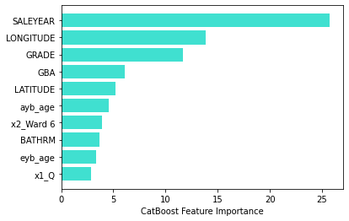
Evaluation
Feature Importances

Slide 42
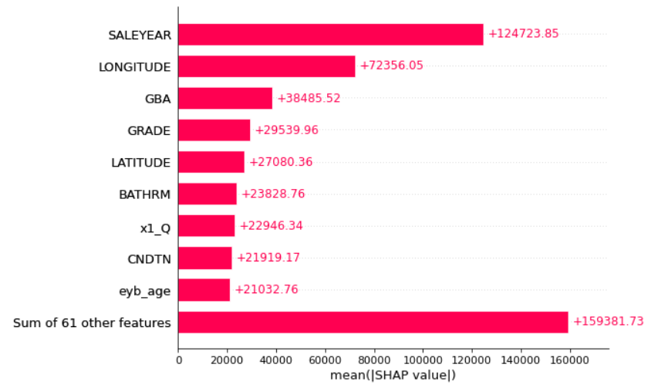
Evaluation
Feature Importances with SHAP

Slide 43
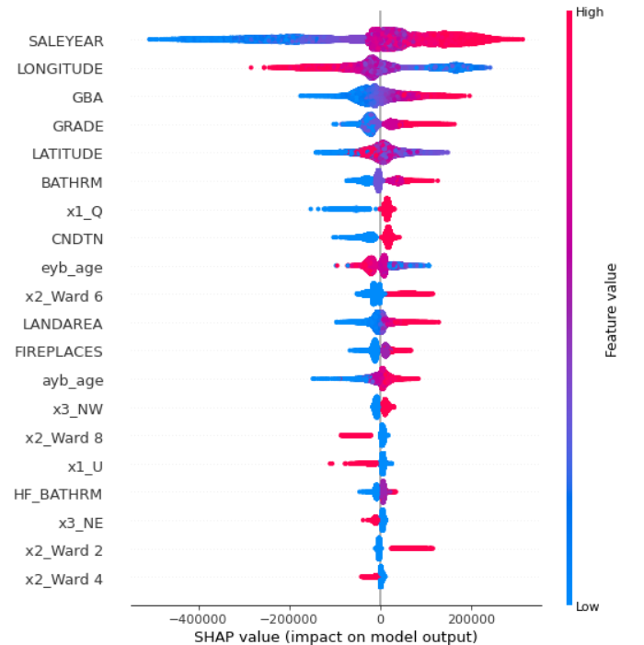
Evaluation
Feature Importances with SHAP

Slide 44
4.
Deployment

Slide 45

Deployment Page
We deployed the model into a webpage format using FLASK.

Slide 46

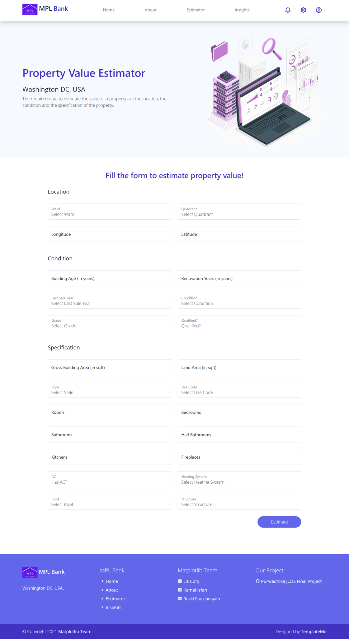
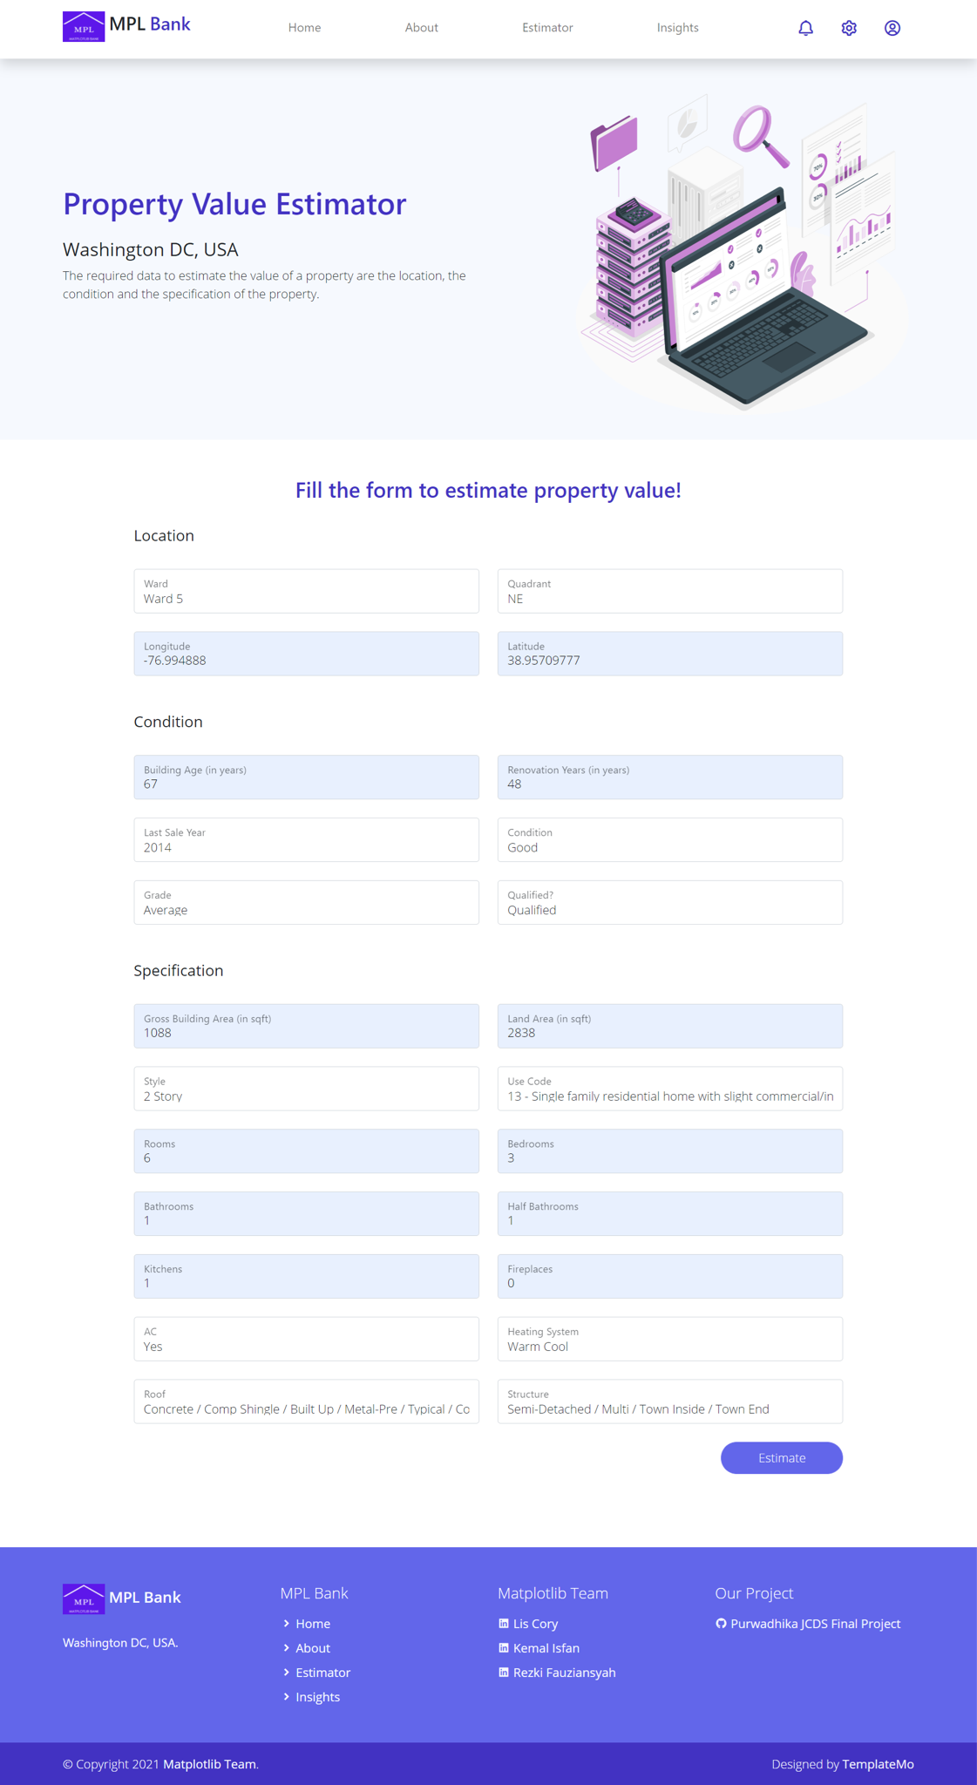

Slide 47
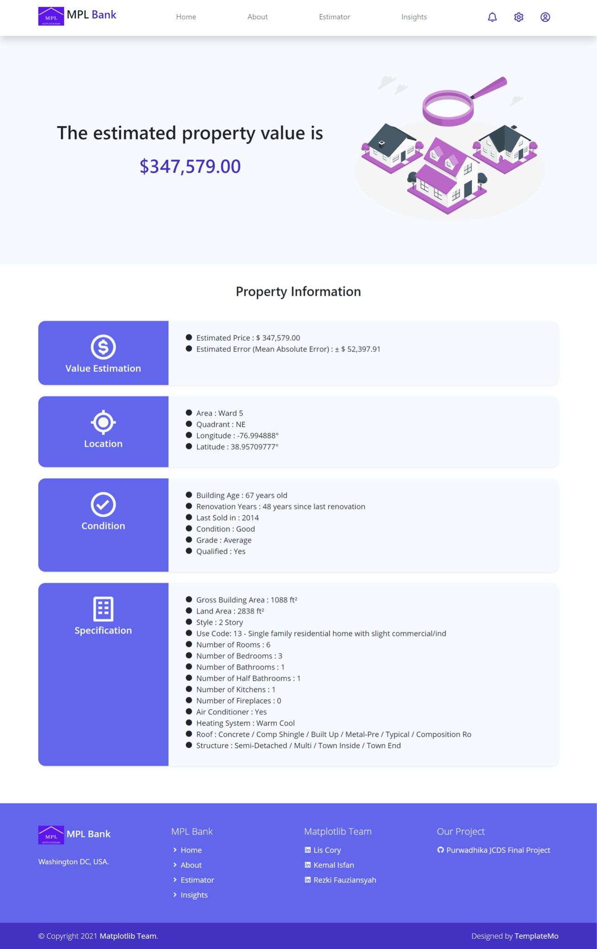
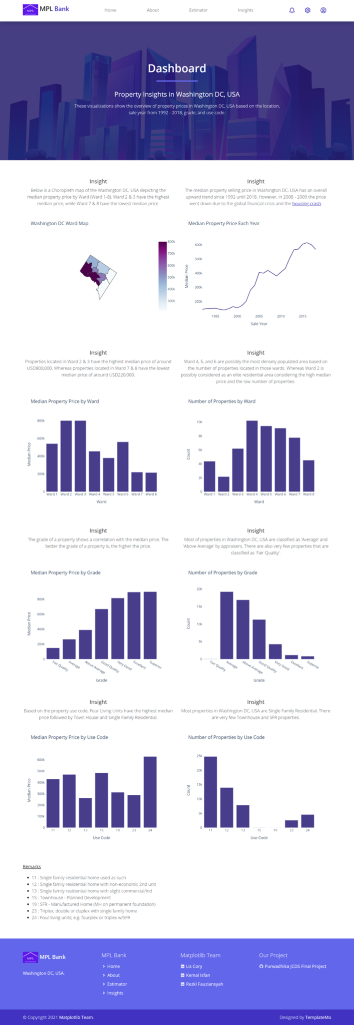

Slide 48
5.
Future Works

Slide 49
Future Works
We acknowledge that results achieved are not perfect as there are more factors that could affect property prices such as proximity to public services and facilities, tourism spots, purchasing power, area development prospect, etc.
These are a few things that might help to improve model prediction result further :
Collect more property data in Washington DC
Get another relevant dataset such as DC Residents Demographic, Public Services and Facilities, etc.
Try to experiment with more features
Use more parameter in grid search cv

Slide 50
THANK YOU!
Purwadhika JCDS 1202 - MATPLOTLIB TEAM
Lis Cory Rezki Fauziansyah Teuku Muhammad Kemal Isfan
GitHub Repository : https://github.com/Kemalisfan/Purwadhika-JCDS-Final-Project

